Slide 1

Forecasting Disney : Weather patterns vs Disney searches

Slide 2

AGENDA
Introduction
1.Are there noticeable differences in Disney Orlando-related search trends between Clear days, rainy days, and cloudy days?
2. Are there more searches for indoor attractions or activities at Disney parks during rainy conditions?
3. How does overall weather patterns, such as seasonal changes or weeks with heavy rain, affect the volume of Disney Orlando-related searches on Google?

Slide 3

Acquiring Data
Weather Data was acquired through Visual Crossing
https://www.visualcrossing.com/
Google search data acquired through Google Trends
https://trends.google.com/

Slide 4
Cleaning Weather Data
Weather Data was downloaded as a CSV file.
CSV file contained multiple column of information that we did not need
We created a new DataFrame called weather_reduced_columns that is a subset of our weather_df DataFrame. The new DataFrame contains only three columns: name, datetime, and conditions.

Slide 5
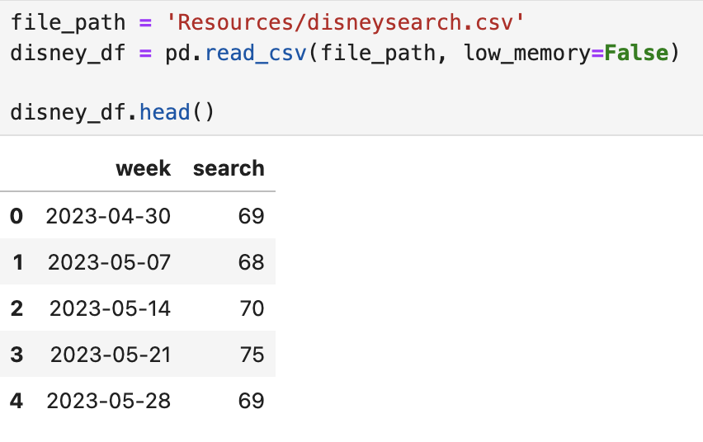
Cleaning Disney Data
Disney Data was downloaded as a CSV file from Google trends.
CSV file contained two columns that were grouped together through the .groupby function to group into separate categories.

Slide 6
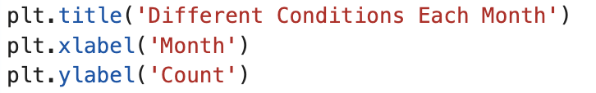

Question 1 Code
Are there noticeable differences in Disney Orlando-related search trends between sunny days, rainy days, and cloudy days?
#Grouped the DataFrame by month and condition
#Counted the number of occurrences for each month and condition
#Plotted the data as a bar graph
#Set Titles and labels
#Show the plot

Slide 7
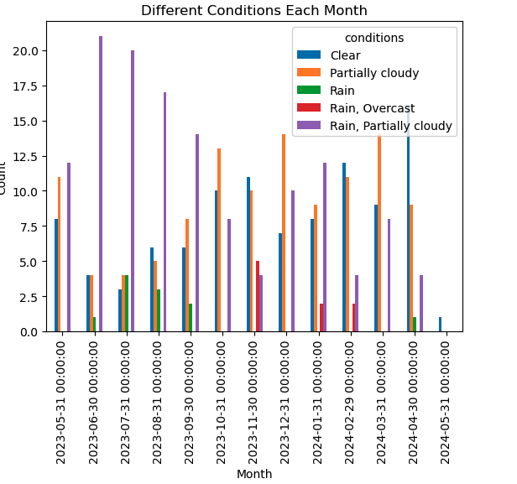
Question 1 Graph

Slide 8

Question 1 Modification
Two main changes to the code
Group the DataFrame by month and condition, and count occurrences
#Set the x-axis tick labels to display the month names

Slide 9
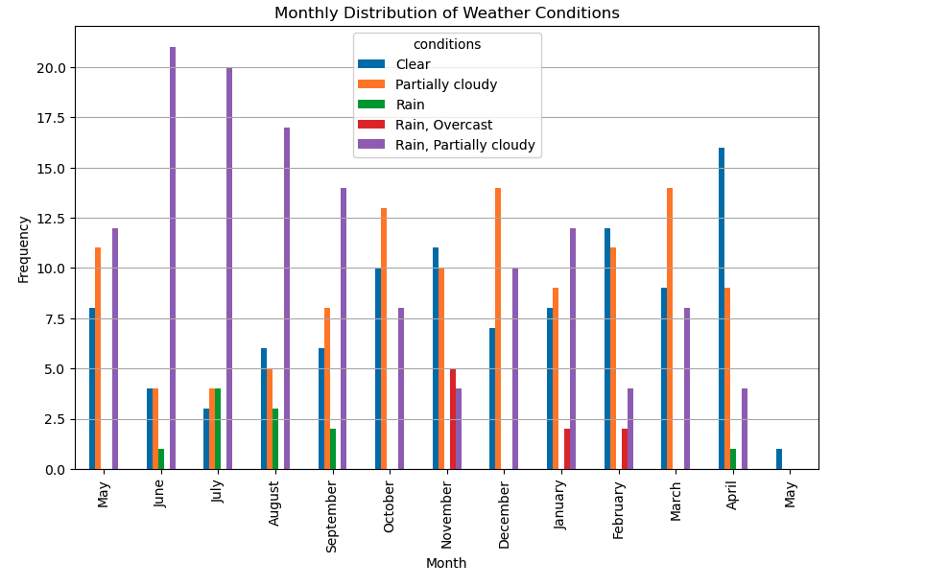
Question 1 Graph

Slide 10
Data Conclusion
June, July, and August saw the most number of rainy days with a combined average of 19.5 days of rain
November, February, and August saw the most number of clear days with a combined average of 13 clear days

Slide 11
question 2
2. Are there more searches for indoor attractions or activities at Disney parks during rainy conditions?
We will be comparing Indoor attractions in Orlando vs Disney parks during raining seasons.
We will show graphs and Bar charts

Slide 12
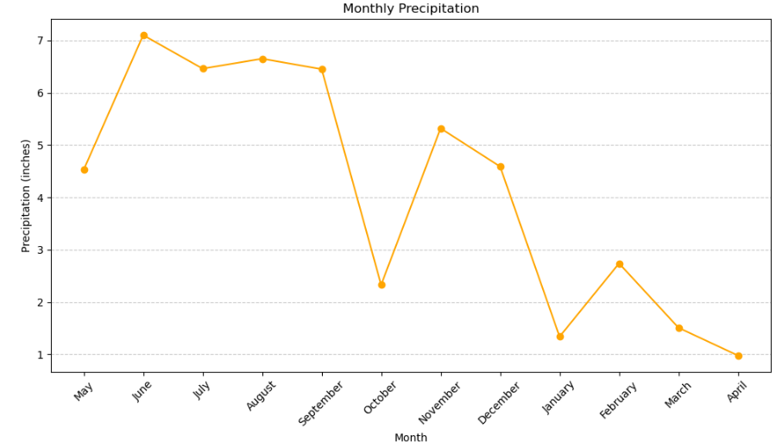
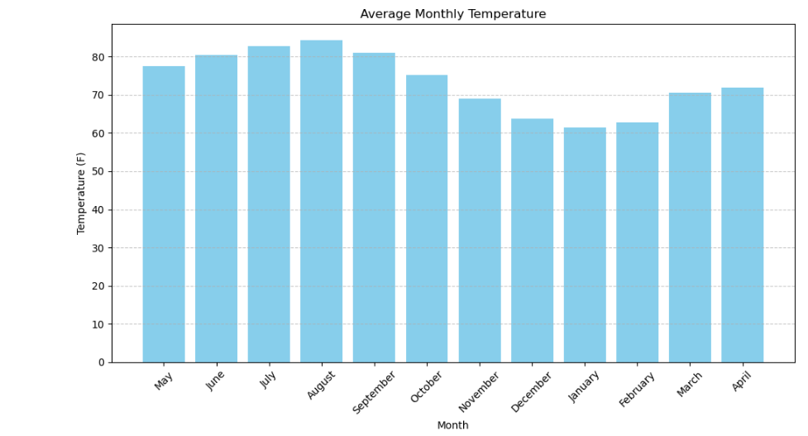
Question Two Graph
This The Monthly Precipitation Average
Y axis is representing the inches average during the precipitation time, ( Months that has a larger volume in precipitation). We are showing the Average monthly temperature, this is also an factor during rainy days, it showing that during hotter days more rain occurs.
We can see that during the moth of June, July, and August is showing the Months that rained the most and the next slide that we are going to present, we will be showing how precipitation can affect the amount of searches on Google comparing to indoor activities.

Slide 13
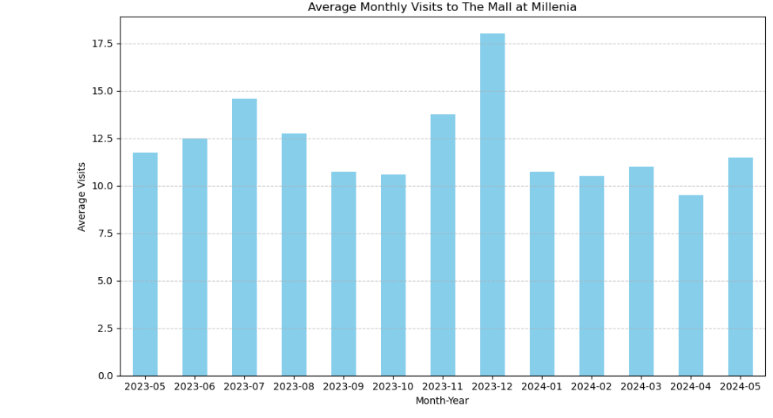
Now let’s compare The number of searches indoor attractions vs Disney Parks
We can analyze and see the number of searches in The Mall at Millenia, which is an indoor attraction, that most turists stop by to shop around and eat in good restaurants.
There was a higher number of searches during November, July, and December of 2023.

Slide 14
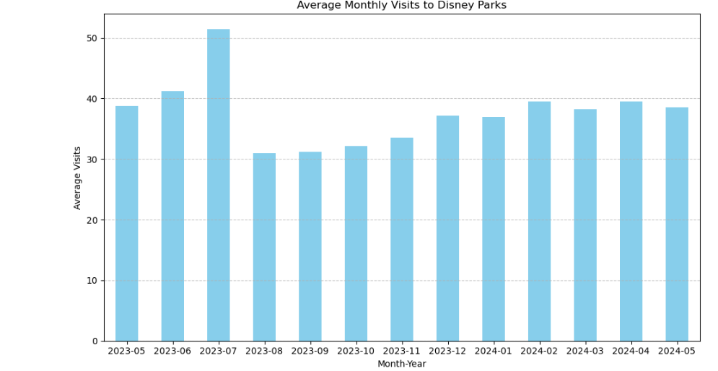
Disney Parks bar graph
Disney Parks number of searches was high during the months of the year where it rained the most, which was May, June, and July. However, August had high precipitation, but the number of searches decreased dramatically.

Slide 15
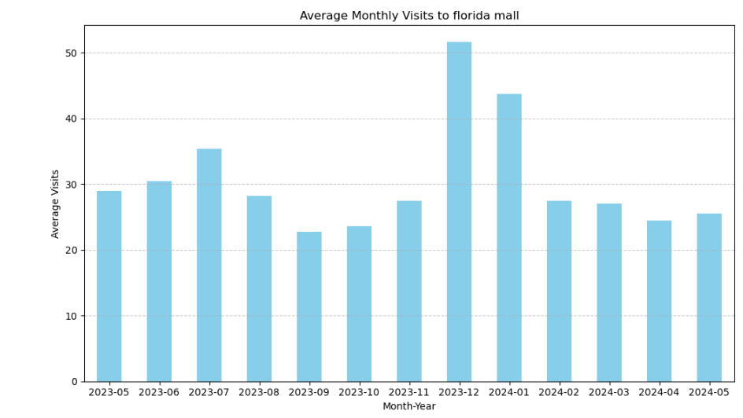
Florida mall searches on google trends
Florida Mall, had a decent number of searches, but it surpasses Disney Parks, during the period in November and December, however, during the raining season, it does not pass the number of searches comparing to Disney Parks.

Slide 16

THANK YOU
Daniel Gomes
Andrew Bullard

